Slide 1
Climate Justice

Slide 2
Let’s hear what Sam and Clover have to say….

Slide 3
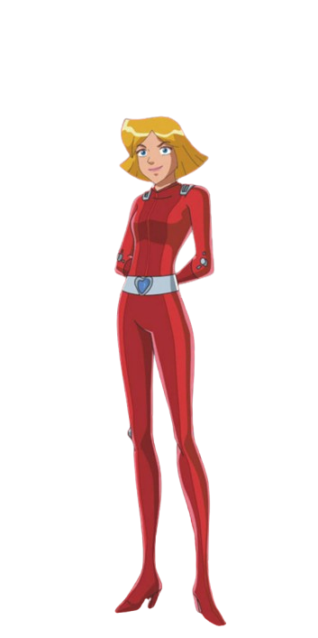
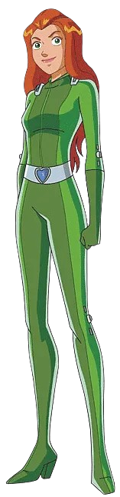
It’s about recognizing that climate change affects different people in unfair ways, especially marginalized communities.
What does climate justice mean?

Slide 4
So, some groups suffer more than others?
So, some groups suffer more than others?

Slide 5
We need policies that support vulnerable communities, ensuring they have access to resources and protection against climate impacts.
How can we address this?

Slide 6
That sounds important! Everyone deserves a fair chance to thrive.

Slide 7
In our pursuit of climate justice, we stand in solidarity with the most vulnerable among us. By addressing the inequitable impacts of climate change, we champion a future where everyone has the opportunity to thrive. Together, we can build a world where justice and sustainability walk hand in hand.

